Slide 1
Publishing Open Access with ACS Publications
Author-Involved Workflow Guide

Slide 2
Submitting Your Manuscript to the ACS

Slide 3
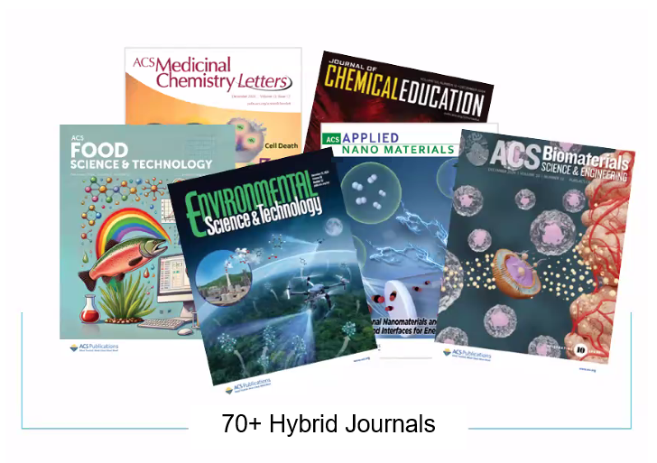
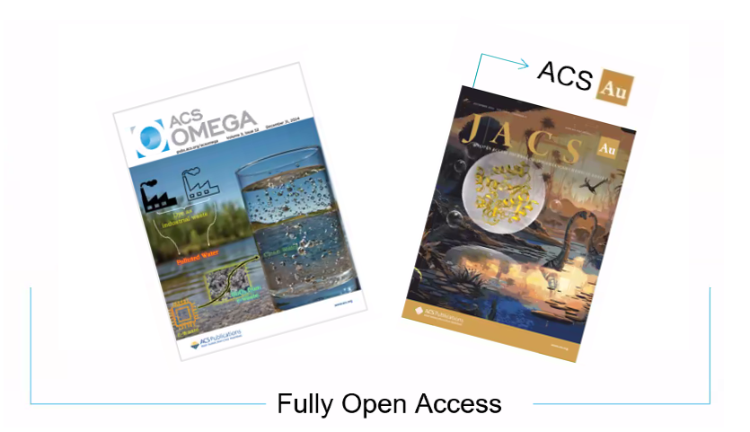
Submission through the ACS Publishing Center
Eligible journals include the ACS hybrid journals, fully open access journals including the gold (Au) suite of journals, and ACS Omega.

Slide 4
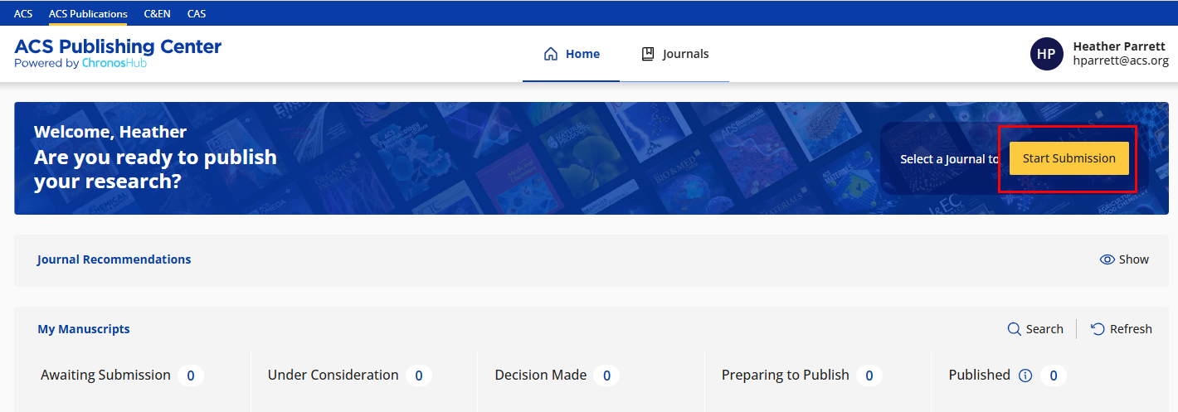
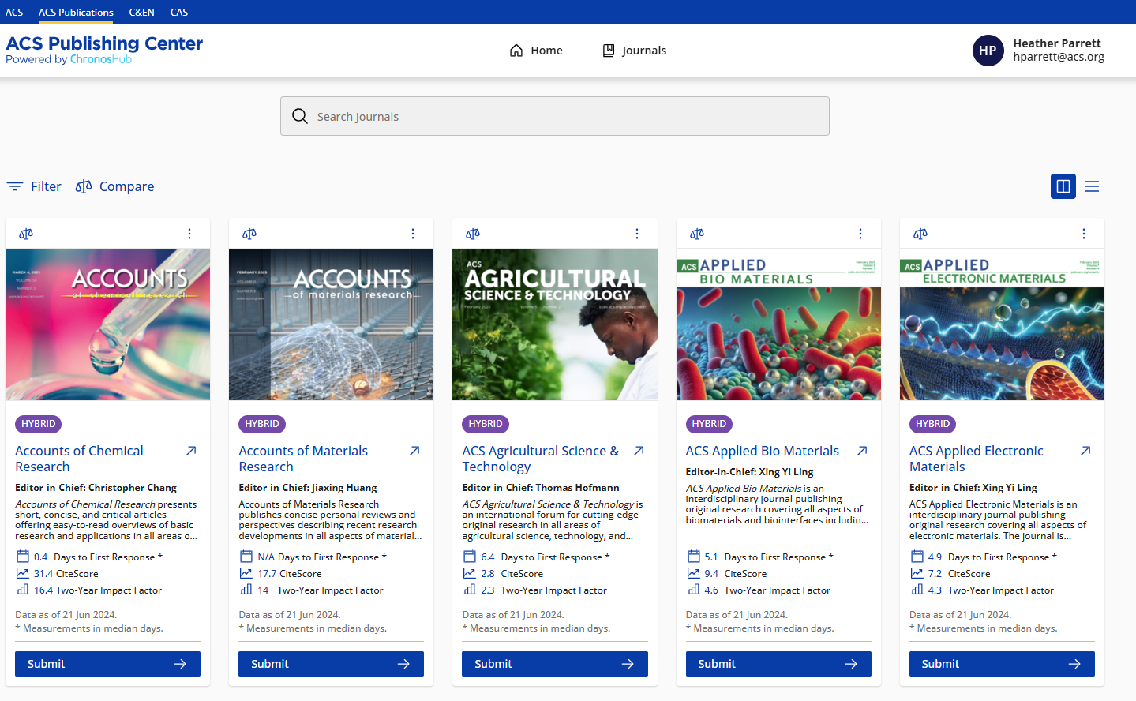
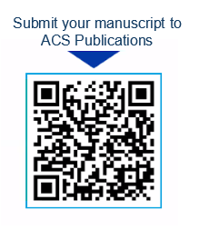
Submission through the ACS Publishing Center
Visit the ACS Publishing Center at https://publish.acs.org/publish/.
Log in using your ACS ID.
Click Start Submission.
Click Submit under the journal you wish to submit to.

Slide 5
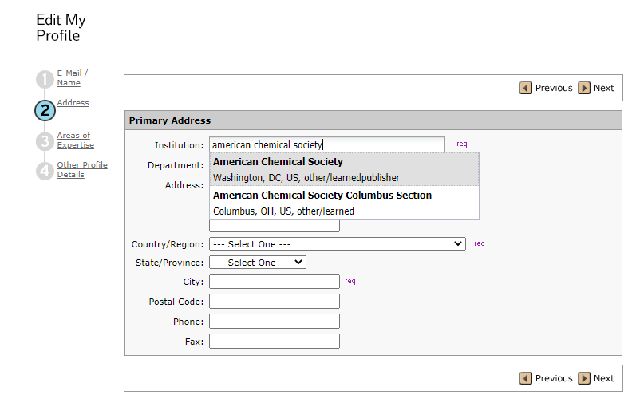
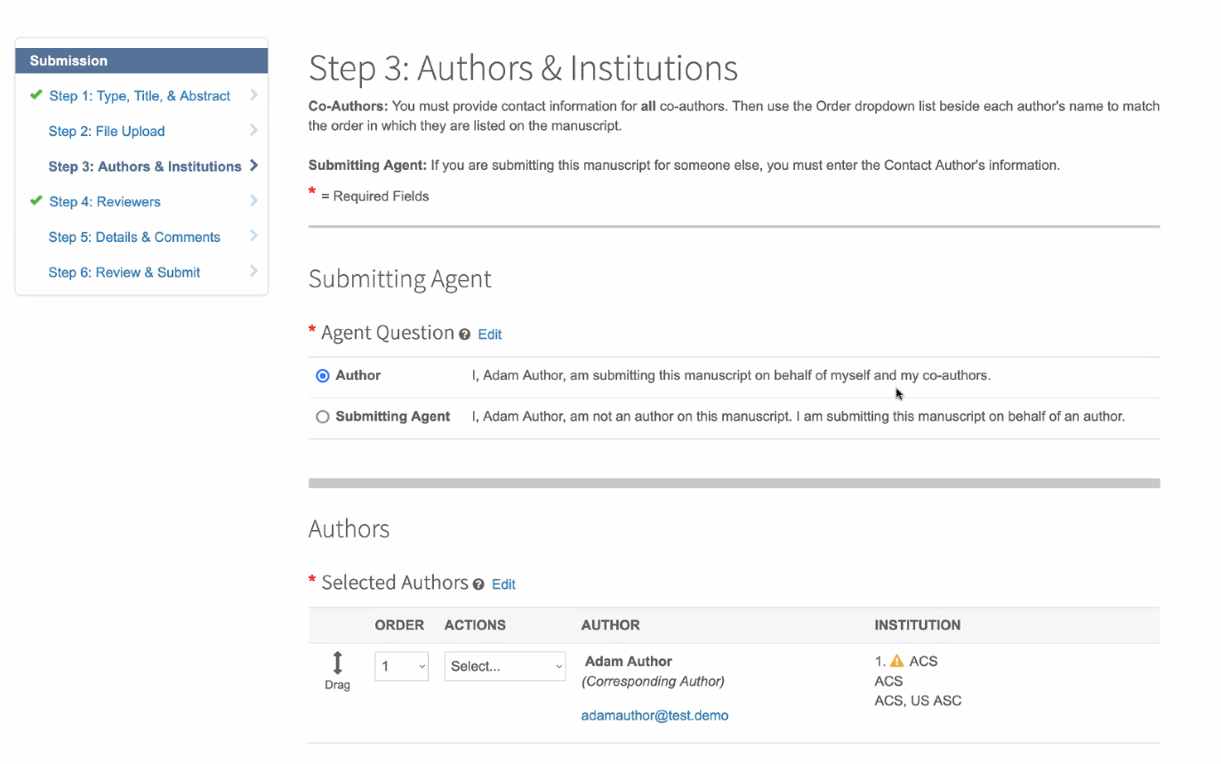
Submission through the ACS Publishing Center
Qualification through the open access agreement is systematically based on the submitting authors primary affiliation at the time of manuscript submission.
During the submission process, please ensure the affiliation in the Submitting Agent field and the Author & Institutions field reflect your affiliation. The affiliation in both fields should show the same institution.

Slide 6
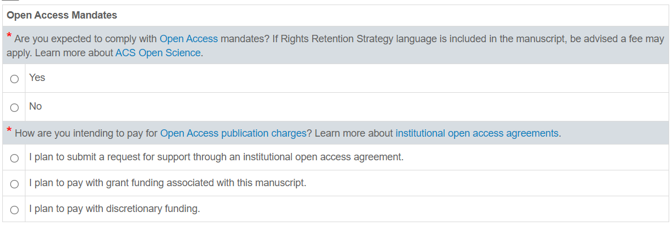
Submission through the ACS Publishing Center
Authors will be asked if they need to comply with any open access mandates and how they may pay for any required open access publication costs.
Note: The answers to these questions do not determine qualification through an agreement. The questions were designed to get the authors thinking about open access and how the APC may be covered.

Slide 7
Completing Your
Journal Publishing Agreement (JPA)

Slide 8
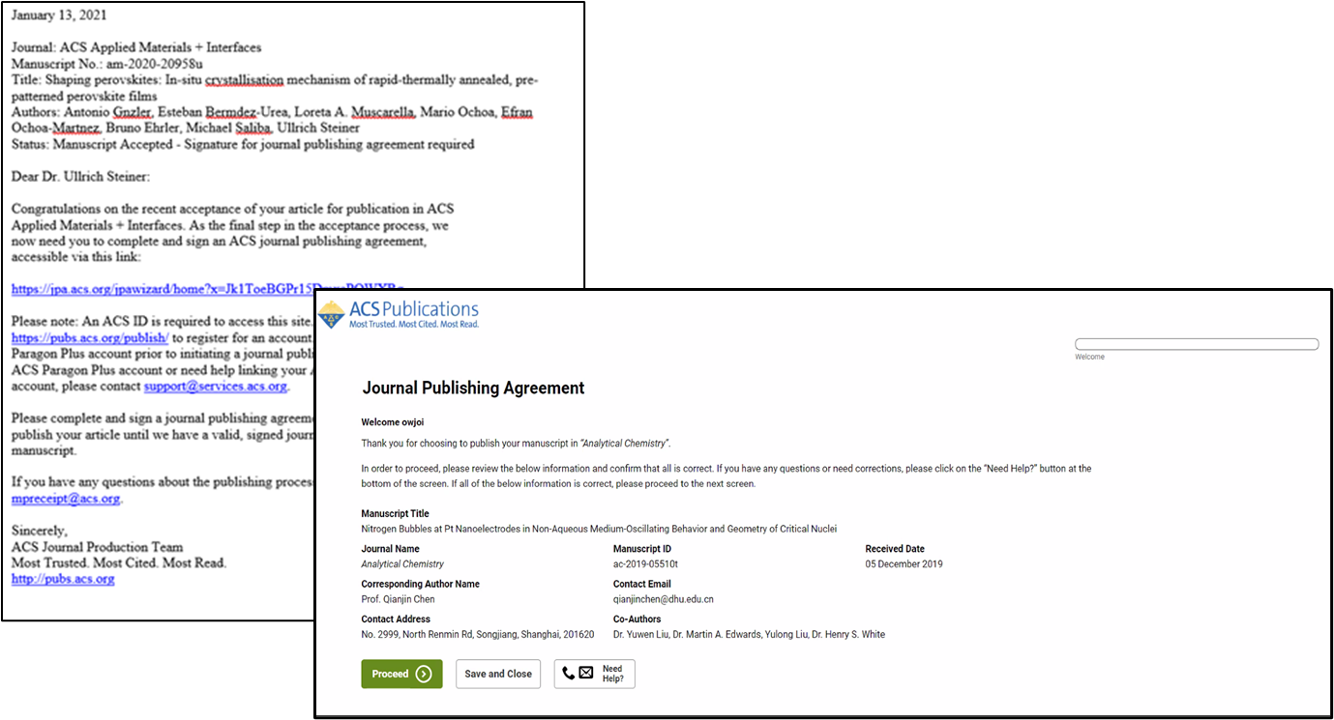
Journal Publishing Agreement
The submitting author is sent an email invitation when the manuscript has been accepted requesting the completion of the Journal Publishing Agreement (JPA).
A link to complete the Journal Publishing Agreement is contained within the email.

Slide 9
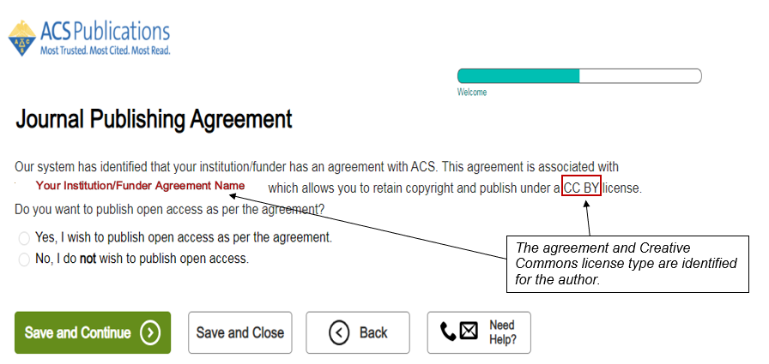
Journal Publishing Agreement
The JPA assistant will identify that an author is affiliated to an open access agreement.
Authors selecting the Yes, I wish to publish open access as per the agreement option will retain copyright. An approved funding request or payment of the APC must be completed for the manuscript to publish.
Authors selecting the No, I do not wish to publish open access option will transfer the copyright to the ACS. The manuscript can still be published as open access, but copyright will remain with the ACS.
Note: Authors publishing in a gold journal will not be required to complete this step if the agreement provides coverage for gold journals.
The JPA is NOT a funding request.

Slide 10
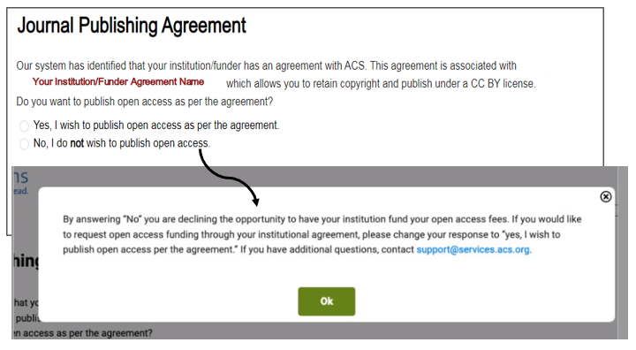
Journal Publishing Agreement
If the author selected the No, I do not wish to publish open access option, the JPA assistant will confirm the author’s intent.

Slide 11
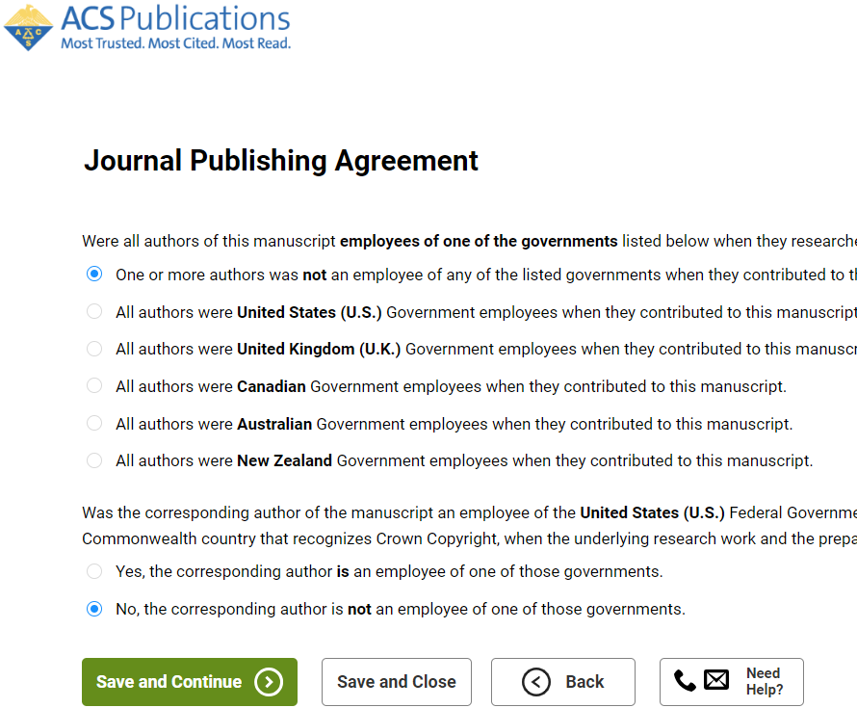
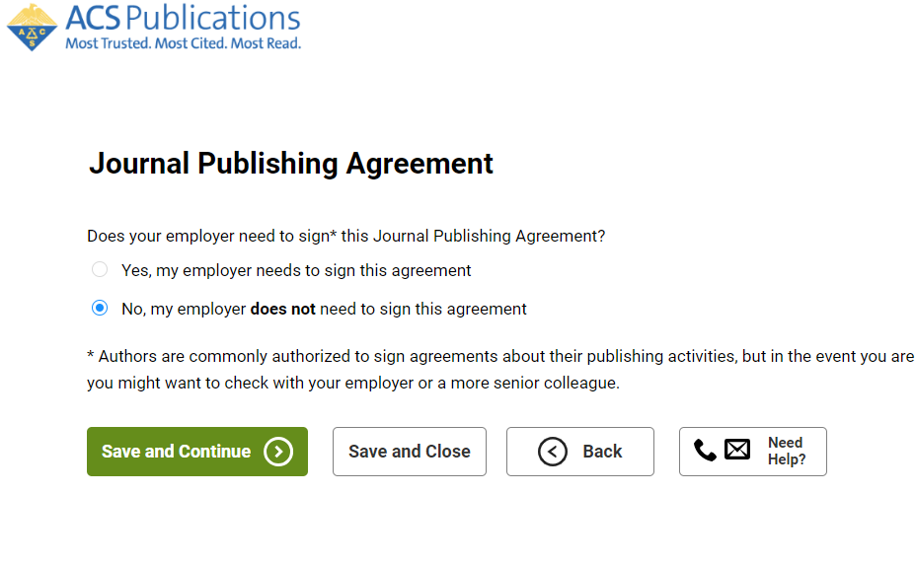
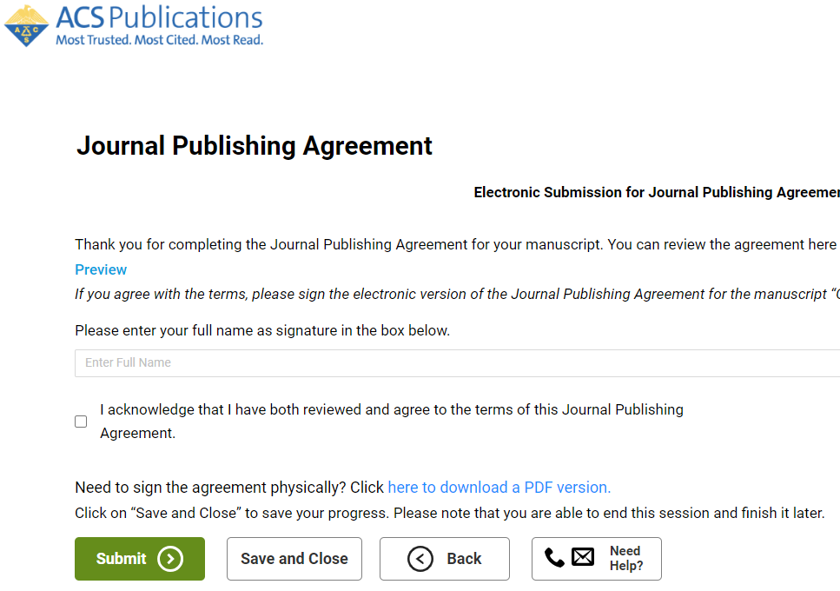
Journal Publishing Agreement
To finalize the JPA, the author should proceed through answering additional questions that are not related to open access.

Slide 12
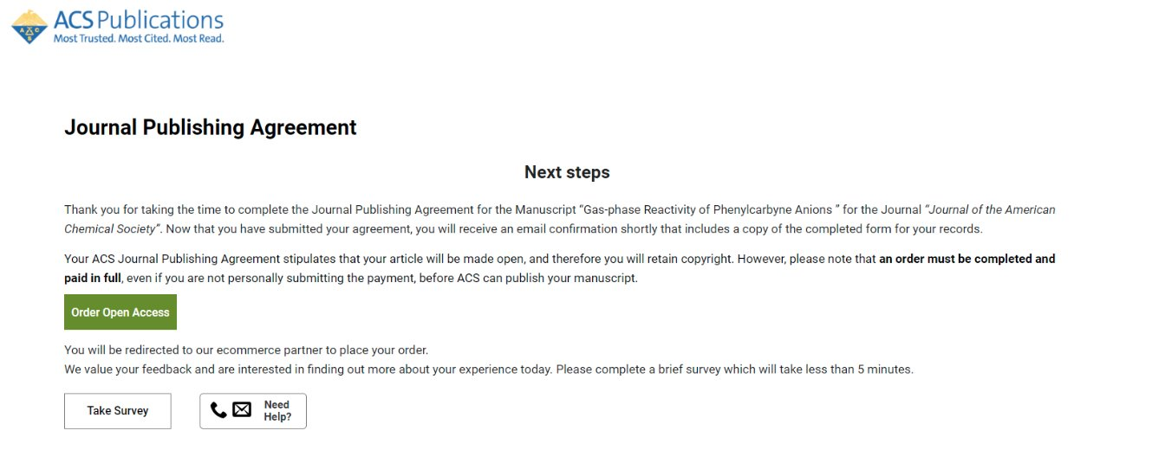
Journal Publishing Agreement
Click the Order Open Access button at the end of the Journal Publishing Agreement process to be directed to Copyright Clearance Center (CCC) to request funding of the APC through the agreement.

Slide 13
Requesting Funding through an Agreement using
CCC RightsLink©

Slide 14
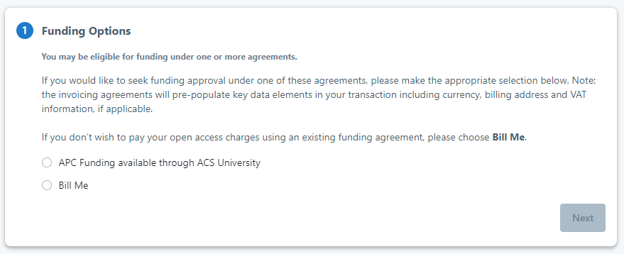
Requesting Funding through CCC RightsLink©
To request funding of the open access APC, the author should select the appropriate option on the Funding Options screen.

Slide 15
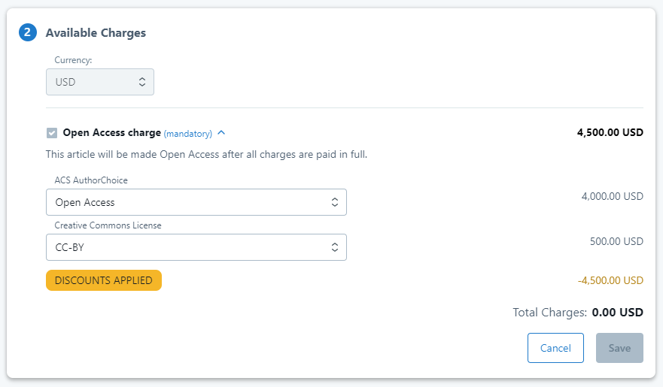
Requesting Funding through CCC RightsLink©
Verify that the appropriate selections have been made and the total charges equal zero dollars.

Slide 16
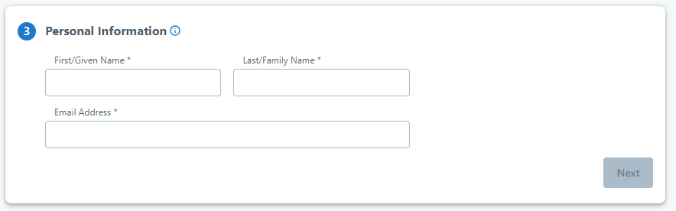
Requesting Funding through CCC RightsLink©
The author should enter their First Name, Last Name, and Email Address and select Next.

Slide 17
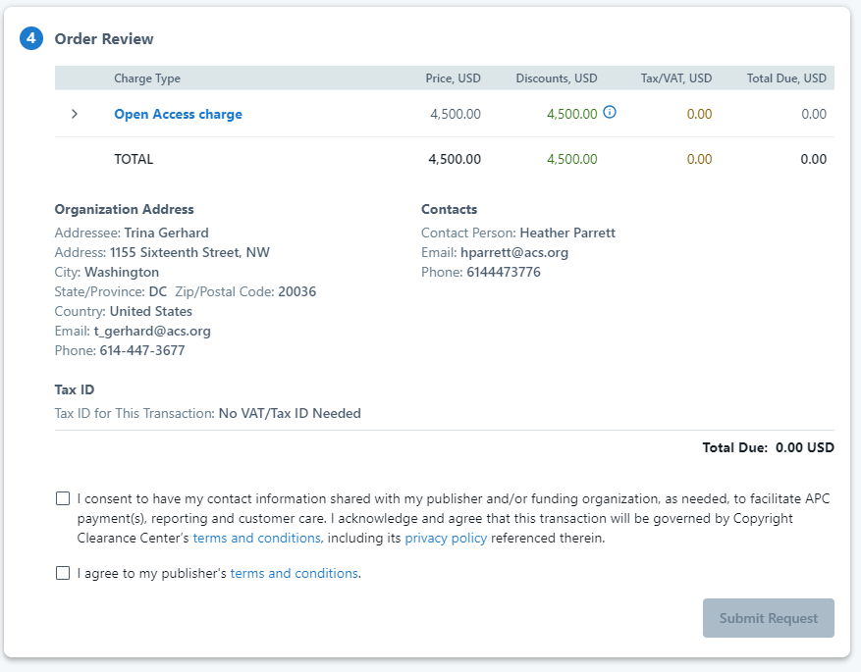
Requesting Funding through CCC RightsLink©
Verify that the order total is zero dollars, accept the terms and conditions, and click the Submit Request button.

Slide 18
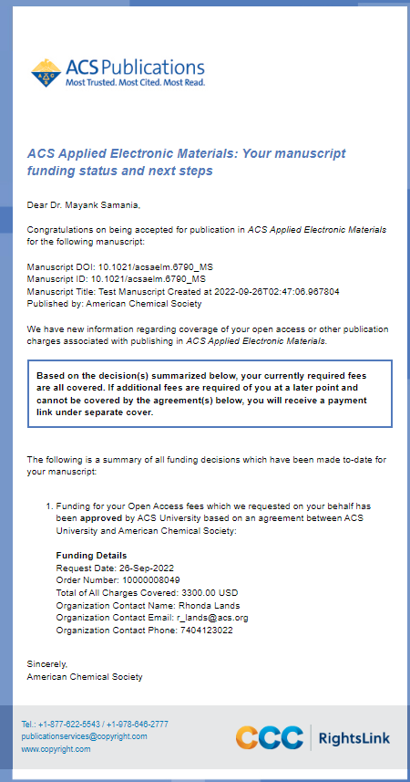
Funding Approval
If the funding request is approved, the author will receive an email notification.
The manuscript will publish as open access when the ACS production process is complete, and the manuscript is ready to be published online.

Slide 19
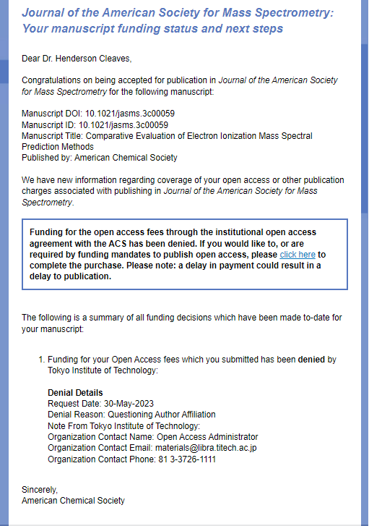
Funding Denial
If the funding request is denied, the author will receive an email notification.
The author may choose to self-pay the APC by clicking the link in the email. The author will be directed to CCC to complete the order.

Slide 20
Resources
Contact
ACS Open Access Operations
OAOps@acs.org
ACS Open Science Website
https://acsopenscience.org/
ACS Open Access License and Pricing Options
https://pubs.acs.org/page/4authors/authorchoice/options.html#optiona
Understanding Copyright and the Journal Publishing Agreement
https://pubs.acs.org/page/copyright/journals/jpa_index.html
FAQs about the ACS Journal Publishing Agreement
https://pubs.acs.org/page/copyright/journals/jpa_faqs.html
Training & Resources
Watch short, instructional videos on the ACS Open Science Resource Center
https://acsopenscience.org/open-access/purchasing-open-access/publish-open-access-read-publish-agreement/

